Slide 1
Censorship COS 432: Information Security
Nick Feamster

Slide 2
Internet Censorship and Information Control

Slide 3
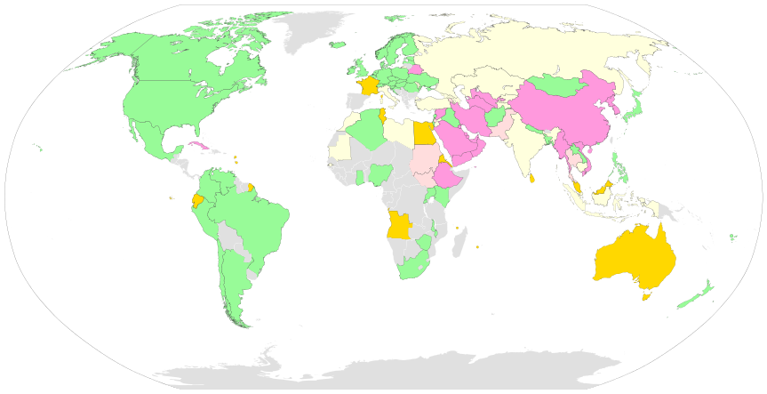
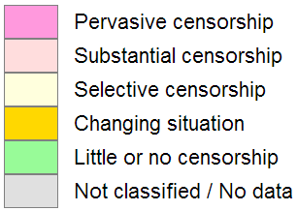
What is Internet censorship?
Internet censorship is policies that governments or organizations use to restrict how people use the Internet.
Number of countries
20
5
19
9
56
Source: ONI and Wikipedia
Notes:
Necessarily a fuzzy definition, since censorship is often a value judgment.
Sometimes use the words “interference” or “filtering” instead.
ONI, Freedom House, Reporters Without Borders have all issued reports

Slide 4
Internet Censorship is Widespread
Practiced in 59 countries around the world
Many western countries
Several electoral democracies (e.g., S. Korea, Turkey) have significant censorship
YouTube blocked in Turkey for two years
Many North Korean sites blocked in South Korea
Twelve countries have centralized infrastructure for monitoring/blocking
Source: Open Network Initiative

Slide 5
Various Anecdotes
In 23 countries, a blogger or Internet user was arrested for content posted online
Chinese woman sent to labor camp for satirical Twitter message
Indonesian woman fined for an email complaining about a local hospital
Twelve countries instituted bans on Twitter, YouTube or some other online social media service

Slide 6
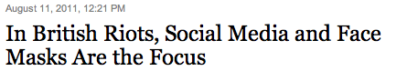

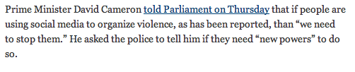
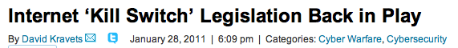


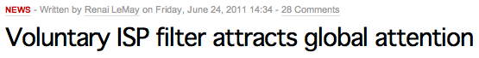
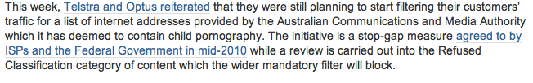
Why do Countries Censor?
Political stability
National security
Social values

Slide 7
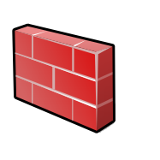


Conventional Internet Censorship
Censor
Censor
Firewall
Alice
Block Traffic
Bob
Censored net
Uncensored net
Punish User
Notes:
“Ok so now I’m going to give you a brief primer on Internet censorship and some existing approaches taken to overcome it.”
“Suppose Alice wants to get some content from Bob. If she accesses the Internet from behind a censorship firewall then the censor may monitor or block communication with Bob, and may even punish Alice for trying to communicate with Bob.”

Slide 8
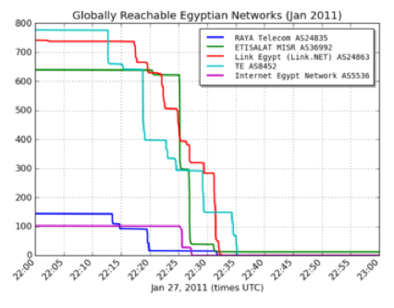
Example: One Type of Censorship
ISP acts on instructions from a judge, government official, etc.
Filtering: IP address, DNS
Keyword-based: search for keyword in URL
China, Iran, Tunisia have such systems in place
Common: Use of centralized infrastructure (e.g., routing)
Source: Renesys

Slide 9
Talk Outline
Scalable, continuous measurement of Internet censorship (Encore)
Counter-intelligence against the Chinese Great Firewall (detecting “active probing”)
Measuring and combatting manipulation and propaganda (Bobble)

Slide 10
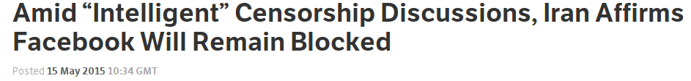
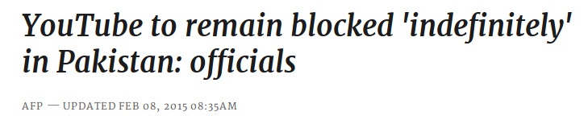
Knowledge of censorship often
begins and ends with anecdotes
Notes:
Examples of Web censorship across the globe continuously pop up in the news, as recently as a week ago. Unfortunately, our knowledge of these events both begins and ends with anecdotes.

Slide 11


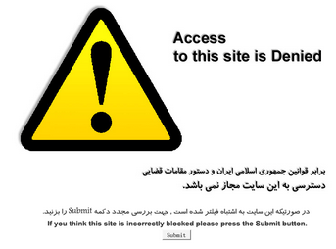
We want more than just anecdotes
What is censored?
Where is it censored?
When is it censored?
How is it censored?
Iran
2009
Notes:
We’d like to move beyond that. For any instance of censorship, researchers hope to learn four things: What is censored, Where it’s censored, When it was censored, and How it’s being censored. For example, in one persistent example, YouTube has been blocked in Pakistan since September of 2012. It’s often enforced via DNS injection to show users a block page like this one.

Slide 12
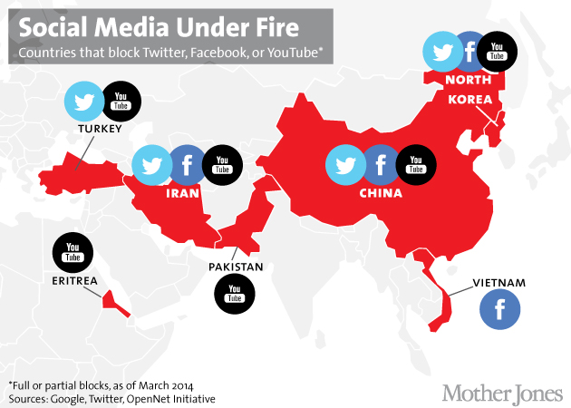
http://www.motherjones.com/politics/2014/03/turkey-facebook-youtube-twitter-blocked

Slide 13
Moving Beyond Anecdotes is Hard
Many locations, languages, and cultures
Recruiting lots of vantage points is necessary but hard
Many censorship mechanisms
Measurements must be flexible
The biggest challenge is diversity

Slide 14





Censorship Measurement Today
Anecdote
(Twitter censored in Iran)
The biggest drawback is scale
Still effectively anecdotes
Political and social scientists want more data
The Citizen Lab, Berkman Center, Princeton, etc.
Researcher
Custom measurement software
Vantage points
Censor
Web service

Slide 15
Encore: Measure using Web browsers
Anecdote
(Twitter censored in Iran)
Custom software
Researcher
Every Web browser is a potential vantage point
Instrumented
Web page
<iframe
src="//encore.noise.gatech.edu/task.html"
width="0" height="0"
style="display: none">
</iframe>
Volunteer Web site
Vantage points
Censor
Web service

Slide 16
Key Contributions
A technique for measuring censorship at scale
A censorship emulation testbed for verifying it
Open source software
https://github.com/sburnett/encore
https://github.com/sburnett/web-censorship-testbed

Slide 17
Encore Outline
Motivation
How to censor the Web
How Encore works
Evaluation
Reducing user risk

Slide 18
Encore Outline
Motivation
How to censor the Web
How Encore works
Evaluation
Reducing user risk

Slide 19

How to Censor Twitter
Domains
NXDOMAIN
Drop request
Inject response
Q: twitter.com?
R: 185.45.5.43
DNS
resolver
TCP SYN
IP addresses
User
TCP SYN-ACK
HTTP GET /
Send RST
Drop SYN
HTTP 200 OK
URLs
Send RST
Drop GET
HTTP 302
twitter.com
Web server

Slide 20
Encore Outline
Motivation
How to censor the Web
How Encore works
Evaluation
Reducing user risk

Slide 21
How Encore Works
Origin Web site
GET /
Vantage point
“Can you access http://twitter.com?”
http://encore.gatech.edu
Web browser
in Iran
Cross-origin
GET /favicon.ico
Measurement target
How?
Censor
http://twitter.com

Slide 22
The same-origin policy makes this harder
An origin is a tuple: (protocol, hostname, port)
https://twitter.com → (https, twitter.com, 443)
Browsers prevent cross-origin data reads:
AJAX requests
Inspection of iframe contents
Cookies and local storage

Slide 23
Encore Doesn’t Need to Read Data
It only needs to know whether a URL loaded.
Restrictions on resource embedding are looser.
Examples:
Images with <img>
Style sheets with <style>
Arbitrary content with <iframe>

Slide 24
Inferring Censorship
Domains
NXDOMAIN
Drop request
Inject response
Many images, same domain
Q: twitter.com?
R: 185.45.5.43
DNS
resolver
IP addresses
TCP SYN
Many images, same IP
Send RST
Drop SYN
User
TCP SYN-ACK
HTTP GET /
URLs
HTTP 200 OK
Send RST
Drop GET
HTTP 302
Load URLs in iframe
twitter.com
Web server

Slide 25
Encore Outline
Motivation
How to censor the Web
How Encore works
Evaluation
Reducing user risk
Notes:
Pause.
This concludes my discussion of Encore’s technical contributions. I’d like to finish with a brief discussion of Encore and the potential risks to which it might expose users.

Slide 26
Why the Worry?
Encore loads potentially censored URLs
Possibly dangerous to users
Informed consent is infeasible
Encore is opt-out

Slide 27
Can We Reduce Encore’s Risks?
Risk depends on usage
What URLs we ask users to measure
Which users run those measurements
Low-risk use cases
URLs often loaded with cross-origin requests
Scalable network availability monitoring

Slide 28
Encore: Summary
Contributions
Encore enables measurement of Web censorship using ordinary Web browsers as vantage points
A technique for measuring censorship at scale
A censorship emulation testbed
Open source software
https://github.com/sburnett/encore
https://github.com/sburnett/web-censorship-testbed

Slide 29
Manipulation and Propaganda
Sock-puppeting: False appearance of independent speakers
Astroturfing: False appearance of a grassroots movement

Slide 30
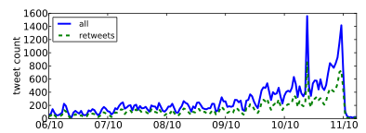
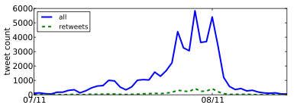
Detecting Propaganda
How can Twitter be used to affect public opinion?
Can we detect when Twitter is being used to spread propaganda?
Nevada Senate Race
Debt Ceiling Debate

Slide 31
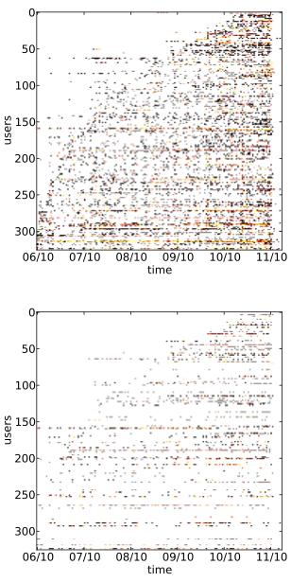
Four Properties of Propagandists
Higher fraction of retweets
More bursty tweeting volumes
Higher daily volumes
Quick retweeting
bias: Measuring the Tweeting Behavior of Propagandists
by Cristian Lumezanu, Nick Feamster, and Hans Klein.
In the Sixth International AAAI Conference on Weblogs and Social Media (ICWSM), 2012.

Slide 32





Personalization as “Filter Bubble”
“A squirrel dying in front of your house may be more relevant to your interests right now than people dying in Africa”
– Mark Zuckerberg
Online personalization is creating situations where we only see things that already suit our own tastes.
Personalization can also be exploited.

Slide 33
Summary
Scalable, continuous measurement of Internet censorship (Encore)
Counter-intelligence against the Chinese Great Firewall (detecting “active probing”)
Measuring and combatting manipulation and propaganda (Bobble)

Slide 34
(The Remainder of this Material is Covered in the Guest Lecture)

Slide 35
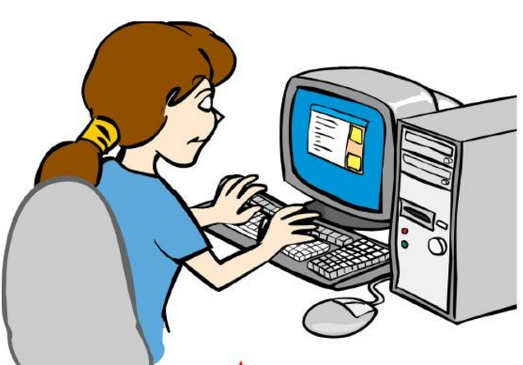
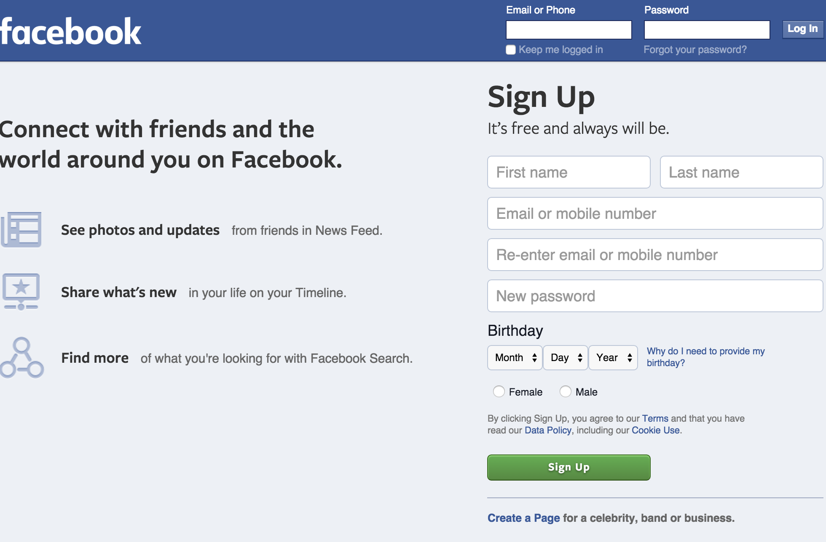

Circumventing Internet Censorship Using Proxies
Internet
Web servers
Notes:
For many of us accessing web servers such as Facebook.com is just typing it in web browsers and there you go.

Slide 36
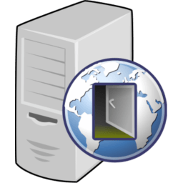
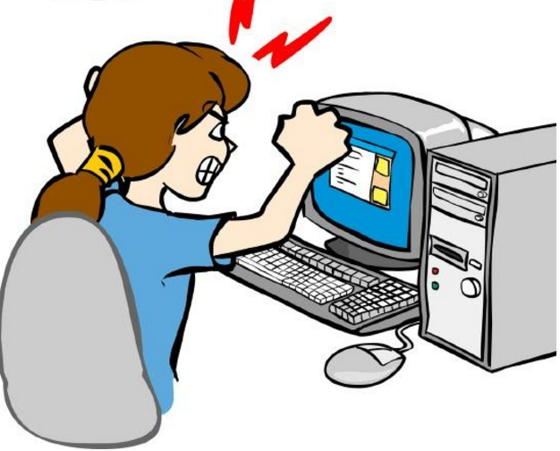
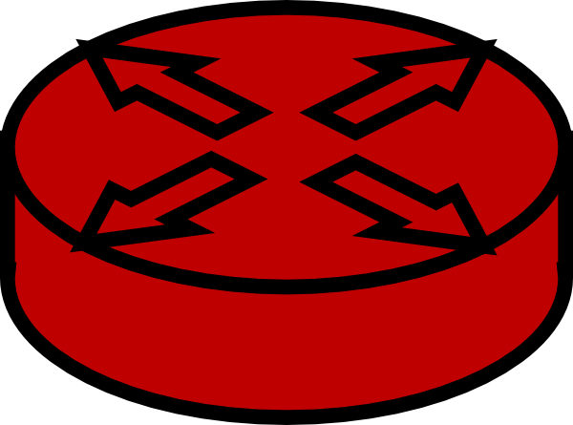

Circumventing Internet Censorship Using Proxies
How do governments find these proxies?
Not everyone can connect to all web servers
Many use proxy servers to circumvent censorship
Governments are getting smarter at detecting proxy servers
Internet
Proxy server
Web servers
Notes:
In this talk our goal is to answer how these governments find these proxies?

Slide 37
How GFW Discovers Hidden Circumvention Servers*
We focus on the GFW and Tor
GFW is a sophisticated censorship system
Tor has a long history of being used for circumventing government censorship
*How the Great Firewall discovers hidden circumvention servers Roya Ensafi, David Fifield, Philipp Winter, Nick Feamster, Nicholas Weaver, and Vern Paxson (IMC2015)
Notes:
To answer to these questions systematically with great details we aim to focus on Chinese censorship apparatus a.k.a GFW and figure how they find these hidden circumvention servers especially tor hidden relays a.k.a Tor Bridges.
We chose GFW because not only it has the sophisticated censorship system, but also, other suppressive regimes have followed their steps for their national firewall implementation. It wasn’t long back ago when China allegedly signed a contract to help one country in their firewall implementation.
We believe our detailed understanding of how GFW is implemented/architected can help Circumvention tool designers to have a realistic view of national firewall capabilities and therefore help them design tools that are sustainable and practical.
We focus on Tor because there has been an interesting decade long arms race between Tor and GFW. Let me give you an overview which covers a necessary background to understand our work.

Slide 38

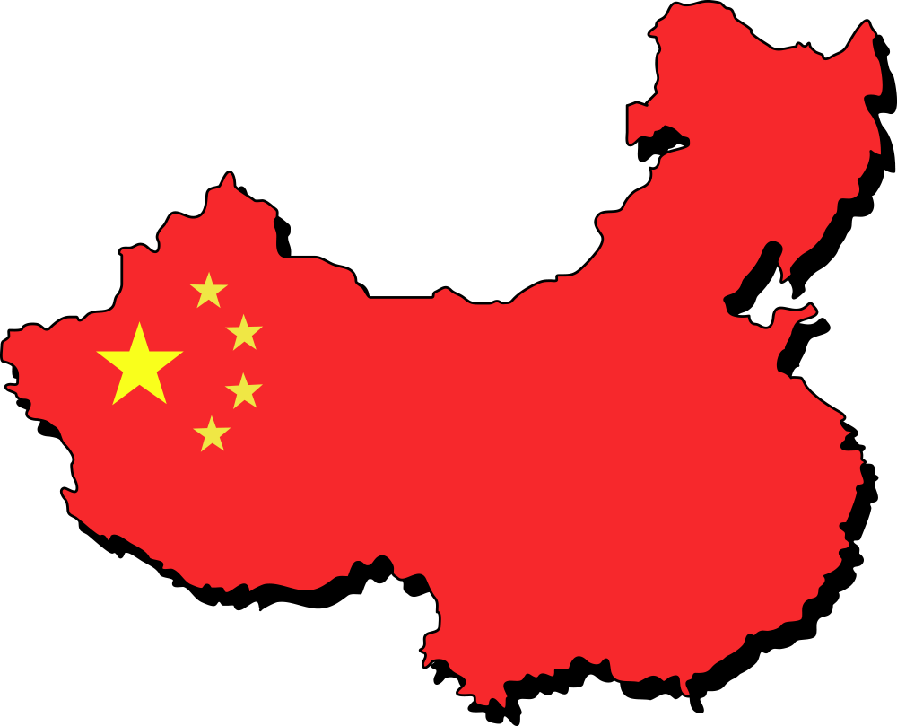
Censorship Arms Race: GFW vs. Tor
Use public Tor network to
circumvent GFW
Time
Notes:
When Tor network gained puplarity.
When GFW realized more than thousands citizens are circumvention their censorship using Tor public network, they went after Tor. They basically download all the relays and block them all.

Slide 39
Censorship Arms Race: GFW vs. Tor
Use public Tor network to
circumvent GFW
Download consensus and block relays
Time
Notes:
When GFW realized more than thousands citizens are circumvention their censorship using Tor public network, they went after Tor. They basically download all the relays and block them all.

Slide 40
Censorship Arms Race: GFW vs. Tor
Use public Tor network to
circumvent GFW
Download consensus and block relays
Time
Introduce private bridges, whose distribution is rate-limited
Notes:
To deal with this issue, Tor developers came up with the idea of Tor Bridge DB, that is a list of Tor relays that are not publicly available therefore no government can EASILY find them and blacklist them.

Slide 41
Censorship Arms Race: GFW vs. Tor
Use public Tor network to
circumvent GFW
Download consensus and block relays
Time
Introduce private bridges, whose distribution is rate-limited
Use DPI to detect Tor TLS handshake
Notes:
Soon after GFW realized that instead of searching for all the relays(proxy servers) they can watch for them by monitoring their citizen’s traffic, So they added DPI box to their infrastructure specifically to detect Tor traffic using fingerprinting.

Slide 42
Fingerprinting the Tor TLS Handshake
TLS handshake is unencrypted and leaks information
Tor’s use of TLS has some peculiarities
X.509 certificate life times
Cipher suites
Randomly generated server name indication (e.g., www.6qgoz6epdi6im5rvxnlx.com)
GFW looks (at least) for cipher suites in the TLS client hello
Notes:
As it turns out, Fingerprinting Tor TLS handshake is not a big deal. First, as you all know, TLS handshake is unencrypted and second Tor TLS handshake has some peculiarities that make it easy to fingerprint.

Slide 43
Censorship Arms Race: GFW vs. Tor
Use public Tor network to
circumvent GFW
Download consensus and block relays
Time
Introduce private bridges, whose distribution is rate-limited
Use DPI to detect Tor TLS handshake
Introduce pluggable transports to hide the handshake such as obfs2, obfs3
Notes:
At first tor project tried to adapt it to look like Firefox talking to apache server.
Tor developers realized this and thus fix this problem by obfuscating Tor traffic to make it less conspicuous.They came up with the concept of pluggable transport which its goal is to wrap the tor traffic in another layer so DPI cannot detect it.

Slide 44
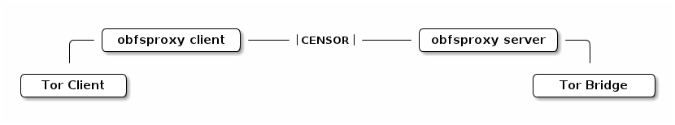
Tor Pluggable Transport
Pluggable transports are drop-in modules for traffic obfuscation
Many modules have been written, but we focus on
obfs2 (First deployed module)
First 20 bytes can be used to detect Tor traffic.
obfs3 (obfs2’s successor)
Makes Tor traffic look like a uniformly random byte stream
Notes:
The first pulggable transport was called obfs 2 and basically obfuscates Tor traffic to looks like a uniformly random byte stream. However, it is implemented in a way that by looking at the first 20 bytes , GFW can detect Tor traffic with high confidence.
So Tor fixed this in obfs3 which makes it harder for reliably distinguish Tor traffic. This means detecting tor traffic out of all these look like random streams would lead to lots of false positives.

Slide 45
Encryption Reduces Blocking Accuracy
Detection of pluggable transports is uncertain
Implies false positives → collateral damage
GFW added active probing to complement the DPI fingerprinting
Notes:
The cost of false positive is much more for national firewalls, especially GFW. Because of huge number of Internet users in China any collateral damage is easily detectable.
However, GFW dealt with this probabilistic detection in a smart way, they added active probing to complement their DPI.

Slide 46
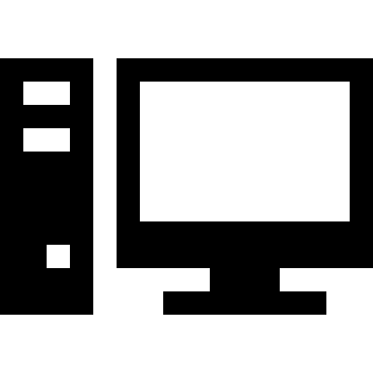

How Does GFW Block Tor Hidden Circumvention Servers?
Network monitoring (e.g., switch mirror port)
DPI for suspicious traffic (e.g., cipher suite)
Actively probing server to verify suspicion
Blocking server
Server in Germany
Block server
Client in China
TLS connection
Tor handshake
Tor handshake
Active prober
Notes:
First GFWs monitor network traffic, and use the DPI to detect suspicious traffic, then they active probe the server by speaking the protocol to verify suspicion if they succeed in establishing the protocol handshake, they block the server
We knew very less about active probing and there where so many unanswered questions.
They lunch a short live probe and speak the protop

Slide 47
Censorship Arms Race: GFW vs. Tor
Use public Tor network to
circumvent GFW
Download consensus and block relays
Time
Introduce private bridges, whose distribution is rate-limited
Use DPI to detect Tor TLS handshake
Introduce pluggable transports to hide the handshake such as obfs2, obfs3
Use DPI + Active probing
Notes:
Tor developers realized this and thus fix this problem by obfuscating Tor traffic to make it less conspicuous.They came up with the concept of pluggable transport which its goal is to wrap the tor traffic in another layer so DPI cannot detect it.

Slide 48
Questions about Active Probing
Implementation: how does it block?
Architecture: how is a system added to China’s backbone?
Policy: what kind of protocols does it block?
Effectiveness: what’s the degree of success at discovering Tor bridges?
Notes:
We soon found out that beside the two blog posts and Philipp’s FOCI paper that provide evidence on this phenomena. There are no other works.

Slide 49
Data: Shadow Infrastructure
Shadow Infrastructure
Clients in China repeatedly connected to bridges under our control
3 months
Packet captures of both the clients and the bridges
EC2-Vanilla
CERNET Network
EC2-Obfs2
EC2-Obfs3
EC2-Vanilla
EC2-Obfs2
Unicom ISP
EC2-Obfs3
Amazon AWS
Clients in China
Notes:
Given the questions the most natural way to answer them is to check what a Chinese user does and experiences and because previous studies suggested users in different ISPs being treated differently in China, we acquired VPS in both CERNET and UNICOMM, the biggest ISP in china. We installed private bridges (Tor vanilla, obfs2, and obfs3) using amazon EC2. Then for 3 months we regularly every five minutes connect from our clients to the bridges. We called this dataset a shadow dataset.

Slide 50
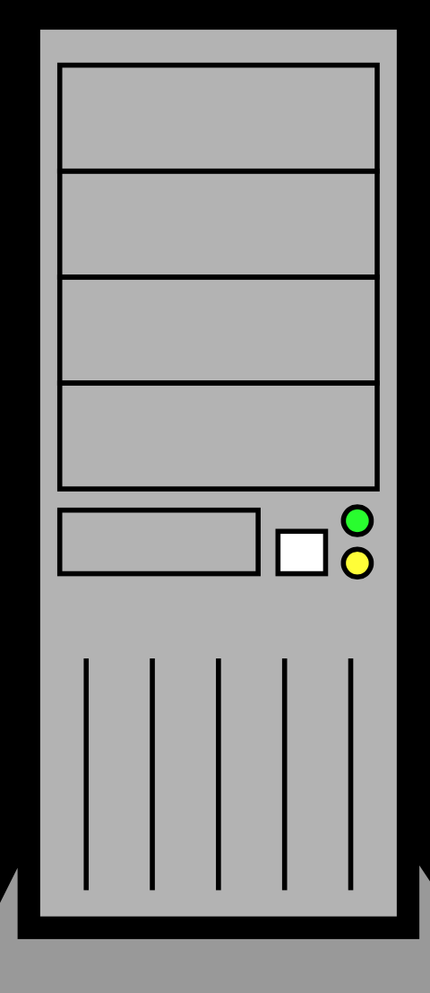

Data: Sybil
Redirected 600 ports to Tor port
Client in China connects to 600 ports
22 hours
Pcap files of both the client and the relay
Sybil Infrastructure
30000
.
.
30300
.
. 30600
Client in China
Vanilla Tor
Forwarding 600 ports to Tor port
Notes:
This dataset answered to some questions we had but not all, so we designed another experiments with the goal of attracting was many active probers. Previous studies showed that GFW is only blocking Tor ORPort so if we run another series on other ports it is accessible. We used this property for our benefit, we forwarded 600 ephermal ports to ORport, so in the eye of the censor our client in China is establishing connection to more than 600 Tor bridges. This experiment lasted 2 hours and we call this dataset a sybil dataset.

Slide 51
Data: Server Logs
Web server that also runs a Tor bridge located in US
Web server logs dating back to Jan 2010
Server Log Analysis
Notes:
We also used David’s 5 years server application logs in order to answer to questions such as when active probing might started. He has been running Tor bridges in the background but he doesn’t have pcaps for Tor port.

Slide 52
Data
Sybil Infrastructure
Shadow Infrastructure
30000
.
.
30300
.
. 30600
EC2-Vanilla
CERNET Network
Client in China
EC2-Obfs2
EC2-Obfs3
Vanilla Tor
Forwarding 600 ports to Tor port
EC2-Vanilla
EC2-Obfs2
Unicom ISP
EC2-Obfs3
Server Log Analysis Application logs of a web server that also runs a Tor bridge since 2010.
Amazon AWS
Clients in China
Notes:
We also used David’s 5 years server application logs in order to answer to questions such as when active probing might started. He has been running Tor bridges in the background but he doesn’t have pcaps for Tor port.

Slide 53
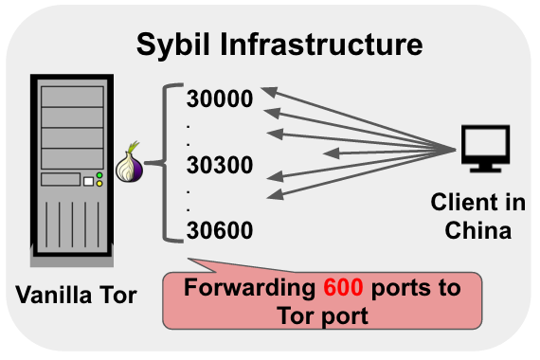
How to Distinguish Probers from Genuine Clients?
Detecting probers in Sybil dataset is easy
Probers:
Visited our vanilla Tor bridge after our client established connections
Originated from China
For the other datasets, we adopt an algorithm
If the cipher suite is in the TLS client hello => Vanilla bridge probes
If the first 20 bytes can reveal Obfs2 => Obfs2 bridges probers
...
Notes:
Well I am sure you are excited to know how we differentiate propers from genuine clients,
Guess what, we fingerprint the probers.
We carefully looked into pacp files and search for patterns layer by layer. Starting by IP layer. Previous research on GFW showed TTL for packets from GFW are weird and limited between 45,51. We observed the same thing for the active probers.

Slide 54
How Many Unique Probers?
Using Sybil, Shadow and Log dataset: 16,083 unique IP addresses
Shadow
135
3 months
Log 14,802
20
2
Sybil 1,090
~ 5 years
GFW’s famous IP: 202.108.181.70
89
22 hours
Notes:
now that we know how GFW finds this proxy servers, and we collected all these cool datasets. what did we learn?
Using these 3 datasets, we learned that GFW rarely use same IP for active probing. We found more than 16000 IPs unique IP addresses which belonged to more than 250 subnets in china. That means we cannot just block the list of active probers to protect discover of our proxy servers. In details we found 158 active prober IPs in shadow datasets from 6 EC2 bridges over 3 months, we found more than 1000 IPs in sybil dataset that was running less than 2 hours and more than 14000 in logs.
158 IP addresses in the Shadow dataset → During 3 months
1,182 in the Sybil → Only in 22 hours
14,912 in the Log → Over the past 5 years
111 of the addresses appear in two of the three datasets
Just one—— appears in all three

Slide 55
Where Are the Probers Coming from?
Reverse DNS suggests ISP pools
adsl-pool.sx.cn
kd.ny.adsl
online.tj.cn
Majority of probes come from three autonomous systems
ASN 4837, 4134, and 17622
Shadow
135
Log 14,802
Sybil 1,090
Notes:
how do we define probes?
first, where are all these probes coming from? they are all from china, but what’s their IP addresses?
if we know their addresses, we could just blacklist them, right?
came up with heuristics to extract probes from our dataset.

Slide 56
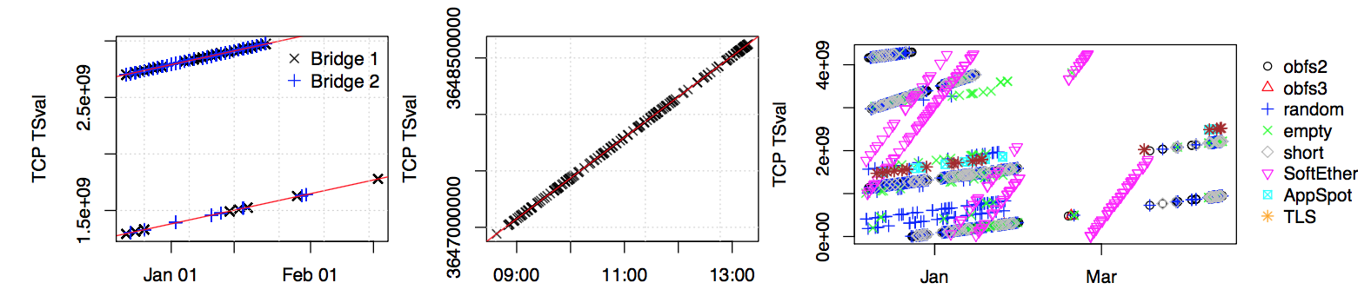
Fingerprinting Active Probers
TCP layer → TSval
TSval intercept: (rough) system uptime
GFW likely operate a handful of physical probing systems
Shadow exp. with 158 Prober IPs
Sybil exp. with 1,182 Prober IPs
Log dataset with 14,912 Prober IPs
Notes:
We found more interesting stuff at TCP layer especially among TCP time stamp values. We plot the TCP TSval values for all our probers from our datasets. The TSval intecepts suggest there are handful physical probing systems with different system uptime…
Handful liner pattern

Slide 57
Can We Fingerprint Active Probers?
TCP layer → ISN
TCP uses 32-bit initial sequence numbers (ISNs)
Protects against off-path attackers
Attacker must guess correct ISN range to inject segments
Every SYN segment should have random ISN
Notes:
Another neat pattern at TCP layer is related to ISN values. To protect TCP connections from on path attackers, initial sequence numbers must not be guessable by an attacker. Modern operating systems use strong randomness to select ISNs. But Initial sequence numbers of SYN segments sent by probers, despite the probers coming from different IP addresses is, a clear linear pattern manifests.

Slide 58
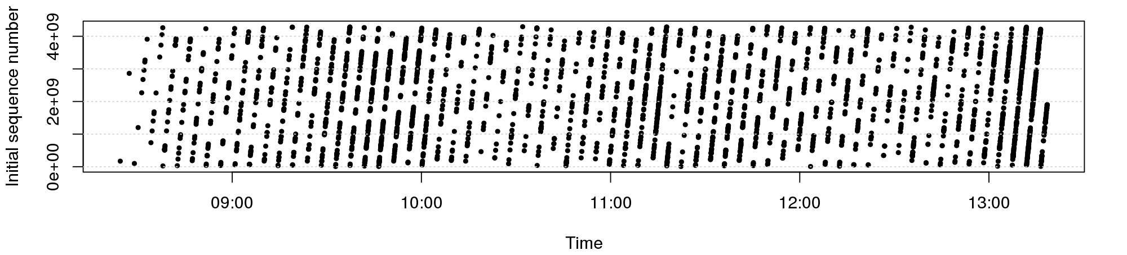
Fingerprinting Active Probers
TCP layer → ISN
TCP uses 32-bit initial sequence numbers (ISNs)
Protects against off-path attackers
Attacker must guess correct ISN range to inject segments
Every SYN segment should have random ISN
Notes:
Another neat pattern at TCP layer is related to ISN values. To protect TCP connections from on path attackers, initial sequence numbers must not be guessable by an attacker. Modern operating systems use strong randomness to select ISNs. But Initial sequence numbers of SYN segments sent by probers, despite the probers coming from different IP addresses is, a clear linear pattern manifests.

Slide 59
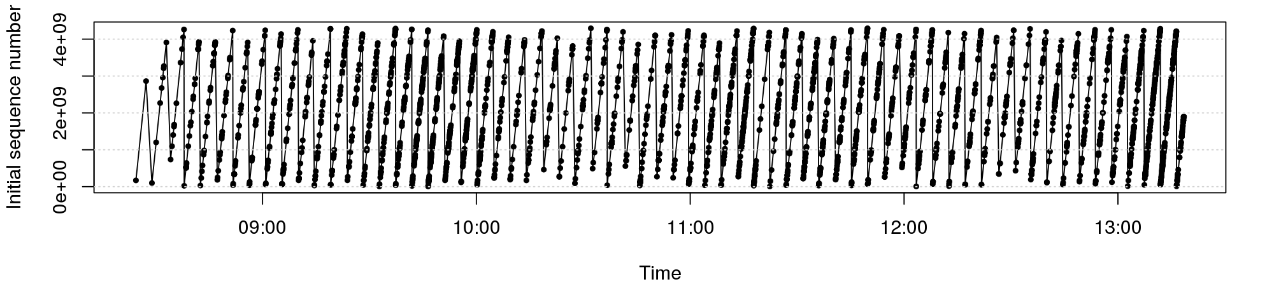
Fingerprinting Active Probers
TCP layer → ISN
TCP uses 32-bit initial sequence numbers (ISNs)
Protects against off-path attackers
Attacker must guess correct ISN range to inject segments
Every SYN segment should have random ISN
Notes:
Another neat pattern at TCP layer is related to ISN values. To protect TCP connections from on path attackers, initial sequence numbers must not be guessable by an attacker. Modern operating systems use strong randomness to select ISNs. But Initial sequence numbers of SYN segments sent by probers, despite the probers coming from different IP addresses is, a clear linear pattern manifests.

Slide 60
What do These Patterns Mean?
Active probing connections leak shared state
ISNs, TSval, source ports, ...
GFW likely operates only few physical systems
Thousands of IP addresses are controlled by central source
Does does not seem like off-the-shelf networking stack
User space TCP stack?
Notes:
Exactly the slide texts

Slide 61
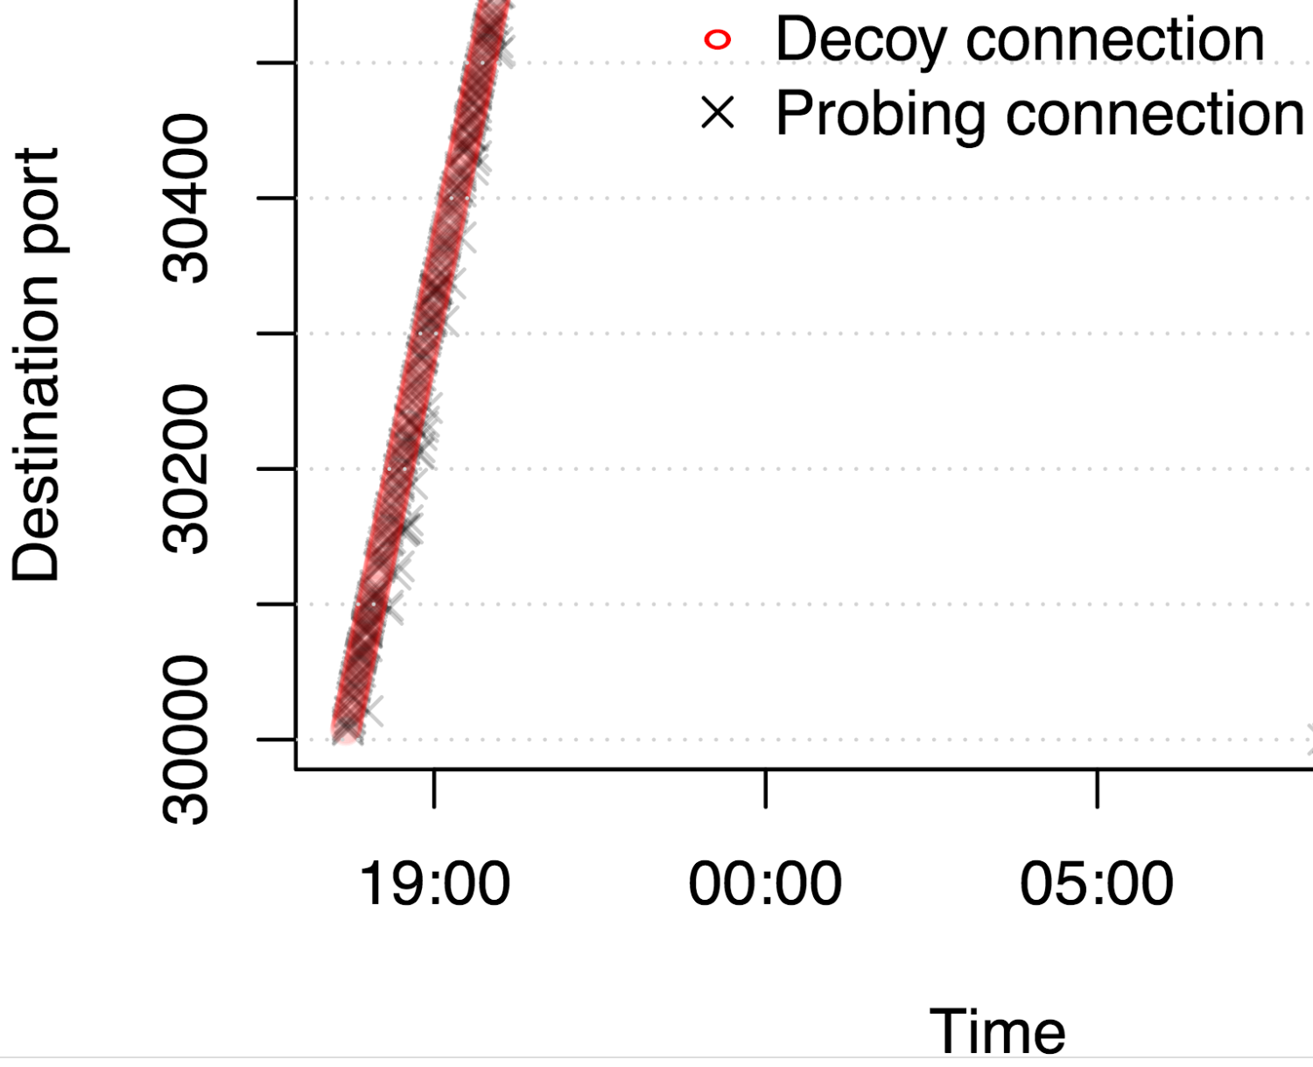
How Quickly Do Active Probes Show Up?
Sybil dataset shows that system now works in real time
Median delay between Tor connection and subsequent probing connection is ~500ms
1,182 distinct probes showed up in 22 hours
Notes:
Previous work suggested every 15 mins and GFW might have probed servers in batches, we showed active probing happens in realtime.
First, 56% of all probing connections arrived after less than one second (median 552 ms).

Slide 62
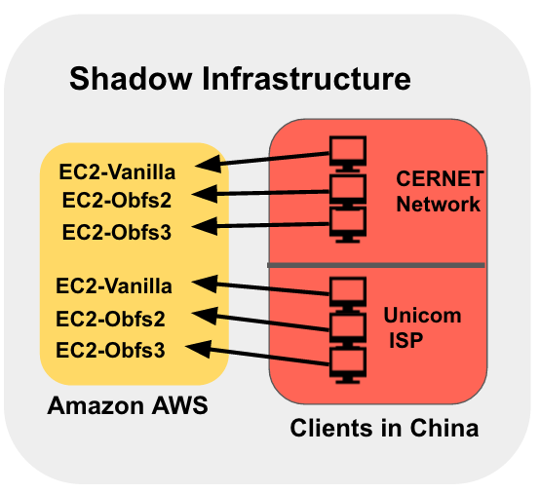
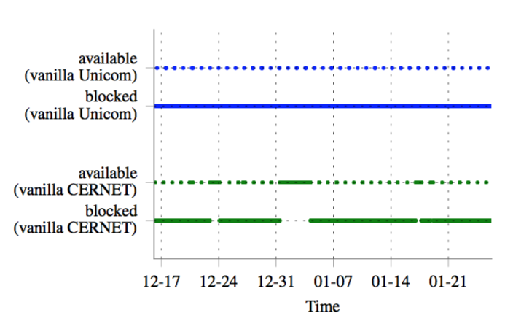
Is Active Probing Effective?
Tor clients succeed in connecting roughly every 25 hours
Might reflect implementation artifact of GFW
obfs2 and obfs3 (~98%) were almost always reachable for clients
Notes:
We looked at 3 months data we collected by establishing Tor handshake every 5 min from Chinese VPS to our EC2 Tor bridges.
obfs2 and obfs3 (~98%) were almost always reachable for clients
Tor vanila was almost alway blocked except roughly every 25 hours. We expect that is implementation artifact for example many commercial firewalls “fail open” when their access control lists are being updated

Slide 63
Active Probing: Summary
Our results show that the active probing system
Makes use of a large amount of IP addresses, clearly centrally controlled
Operates in real time
Probes Vanilla, Obfs2, and Obfs3 Bridge
Notes:
In paper: Can detect at least five circumvention protocols

Slide 64
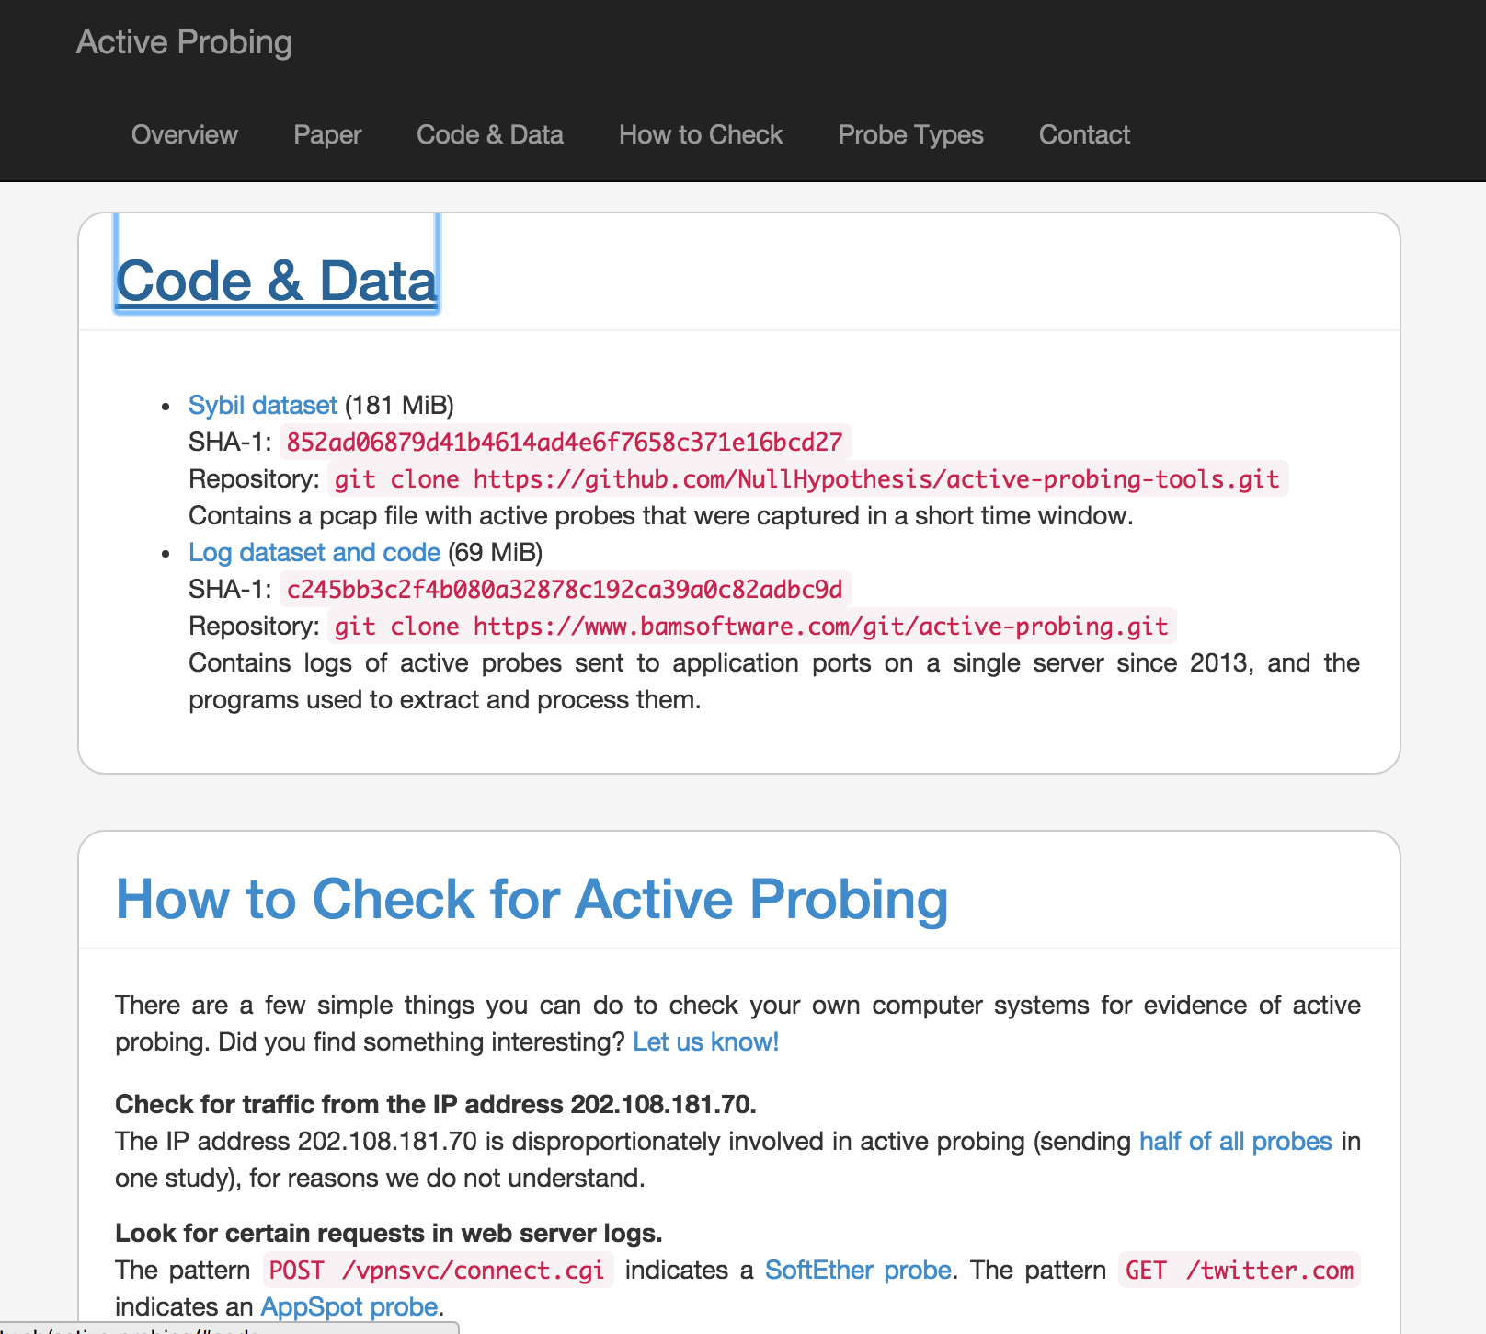
Public Datasets
Project page: https://nymity.ch/active-probing/
Log and Sybil data sets are available online

Slide 65
Extra Encore Slides (Evaluation, Not Covered)

Slide 66
Encore Outline
Motivation
How to censor the Web
How Encore works
Evaluation
Reducing user risk

Slide 67
Evaluating Encore
Does Encore work across browsers, platforms, and modes of filtering?
Can Encore observe real instances of filtering?
How many sites can Encore measure?
What is Encore’s resource overhead?

Slide 68
Evaluating Encore
Does Encore work across browsers, platforms, and modes of filtering?
Can Encore observe real instances of filtering?
How many sites can Encore measure?
What is Encore’s resource overhead?

Slide 69
Encore Deployment
Recruited 17 Webmasters, 2014 May -- 2015 Jan (Ongoing)
Collected 141,626 measurements from 88,260 unique IPs in 170 countries
Orders of magnitude more vantage points
Source code: https://github.com/sburnett/encore

Slide 70
What Did We Measure?
Controlled experiments to verify correctness
Web censorship testbed
Case study with real sites
Small images from Twitter, Facebook, YouTube

Slide 71
Web Censorship Testbed
Examples:
blackhole.noise.gatech.edu -- Drop DNS
encore.noise.gatech.edu:8890 -- Reset TCP
encore.noise.gatech.edu:8892 -- No censorship
github.com/sburnett/web-censorship-testbed

Slide 72
Controlled Testbed Experiments
Emulated censor
GET /pixel.png
blackhole.noise.gatech.edu
GET /pixel.png
Encore user
Control server
encore.noise.gatech.edu:8892

Slide 73

Case Study with Real Sites
Popular sites, often requested cross-origin
Examples: YouTube, Facebook, Twitter
Only favicons
Pakistan
Iran
China

